Slide 1
Communication and Collaboration in IT Projects

Slide 2
Communication Management
Project Communication Management is one of the key knowledge areas in PMBOK.
It focuses on ensuring that timely and appropriate planning, collection, creation, distribution, storage, retrieval, and disposition of project information happens throughout the project lifecycle.
Purpose
To make sure the right information reaches the right people at the right time.
Improves collaboration, decision-making, and stakeholder engagement.

Slide 3
Processes in Communication Management
Plan Communications Management (Planning Process Group)
Define how, when, and by whom information will be communicated.
Inputs: Project Charter, Stakeholder Register.
Outputs: Communications Management Plan (includes methods, frequency, formats).
Manage Communications (Executing Process Group)
Implement the communication plan.
Ensure information is clear, timely, and accessible.
Tools: Meetings, reports, collaboration tools.
Monitor Communications (Monitoring & Controlling Process Group)
Track and evaluate if communications meet stakeholder needs.
Adjust strategies if gaps exist.

Slide 4
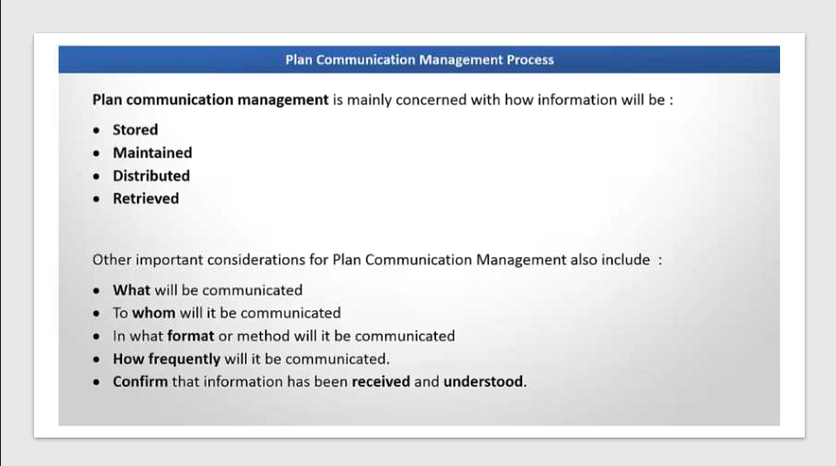

Slide 5
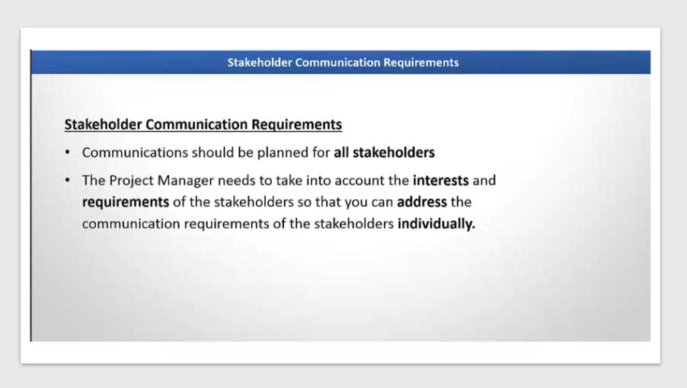

Slide 6
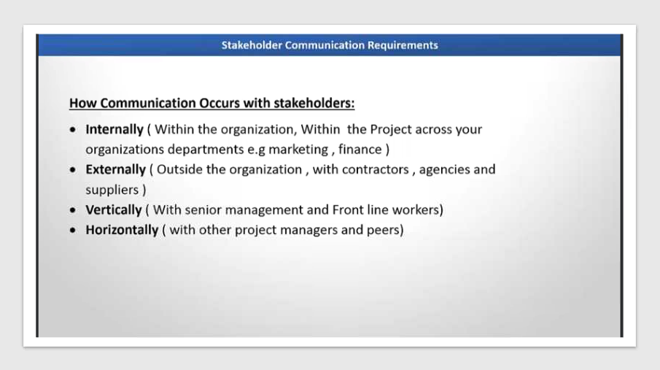

Slide 7
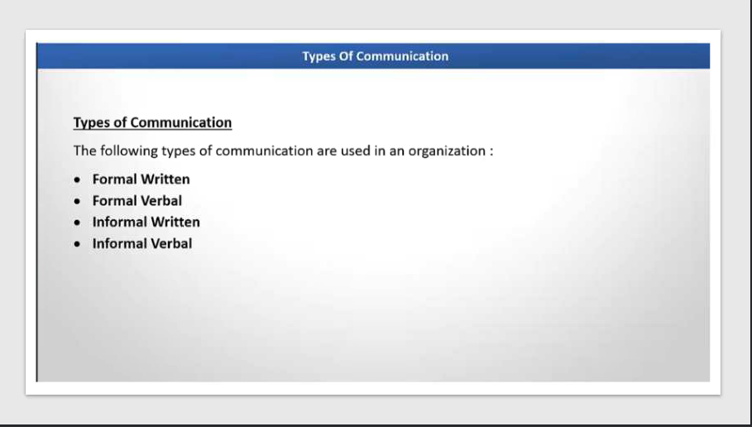

Slide 8
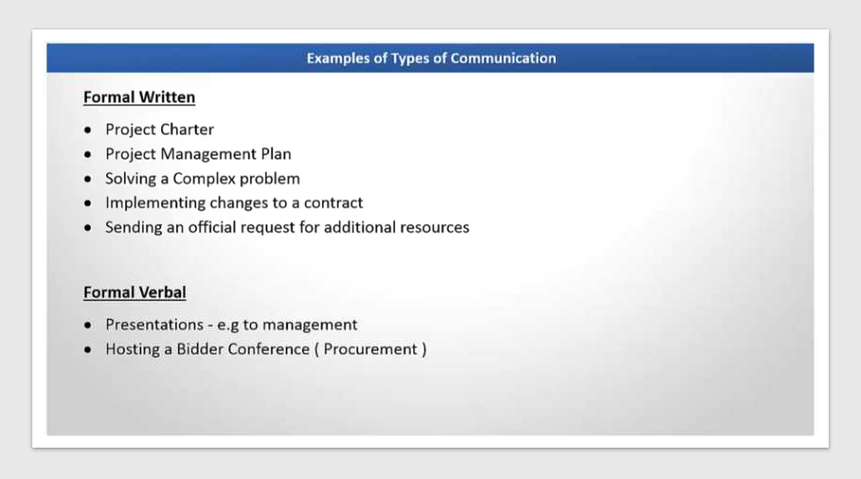

Slide 9
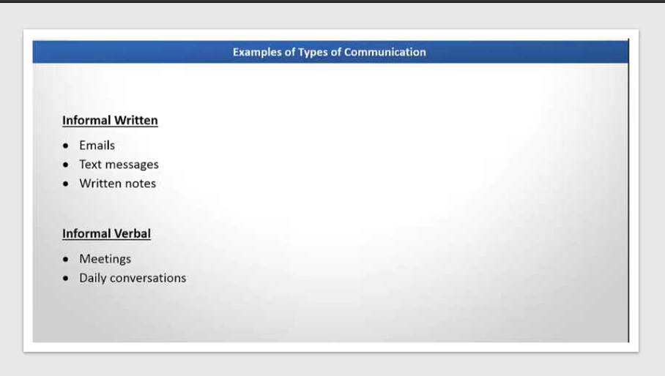

Slide 10
Key Elements
Communication Requirements Analysis: What info is needed by whom?
Communication Methods:
Interactive (meetings, calls)
Push (emails, reports)
Pull (intranet, dashboards)
Channels: Formula for communication channels
Channels=n(n−1)/2
where n = number of stakeholders).

Slide 11
Communication Management
Who is Responsible?
Project Manager: Ensures effective communication.
Team Members & Stakeholders: Follow the plan and provide feedback.
Example
In a software project:
Weekly status reports emailed to stakeholders (Push).
Daily stand-up meetings with the team (Interactive).
Project documents stored in SharePoint for access (Pull).

Slide 12
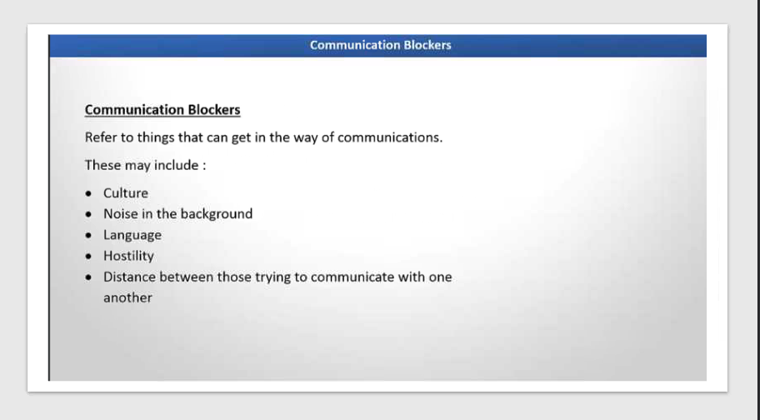

Slide 13
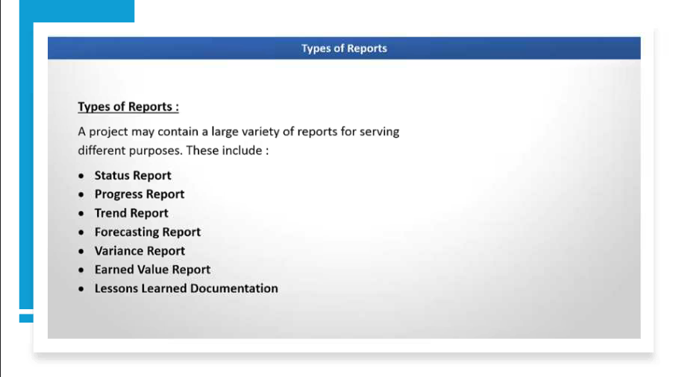

Slide 14
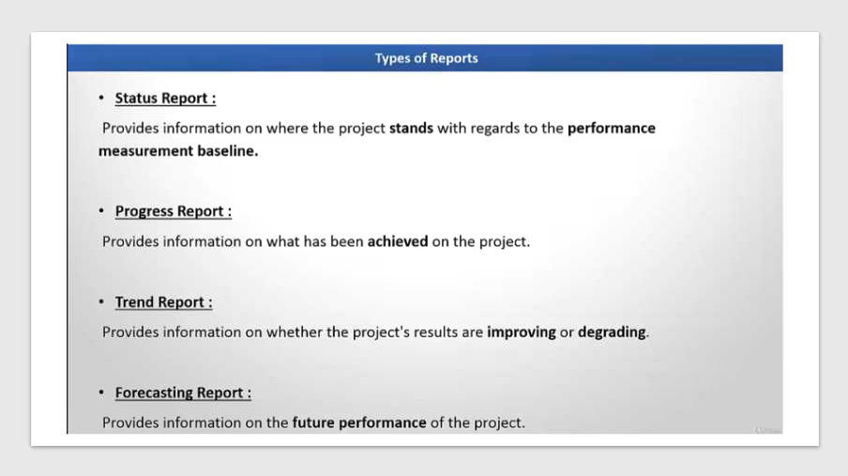

Slide 15
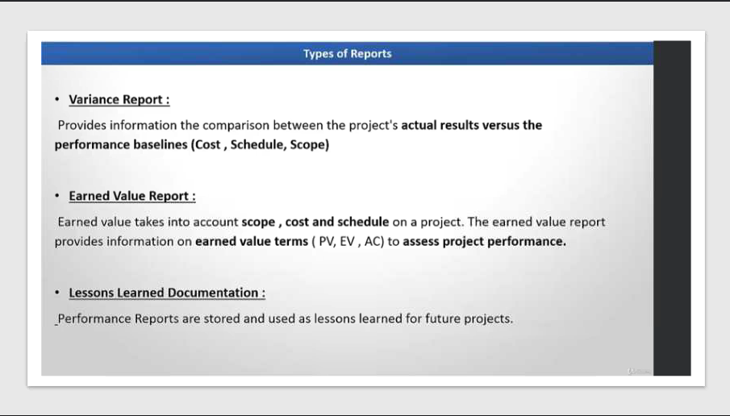

Slide 16
Effective Communication Strategies for IT Teams
Plan Communications Management
Strategy: Define communication needs early.
Example:
Create a Communication Management Plan specifying:
Weekly sprint updates via email.
Daily stand-ups via Teams.
Monthly stakeholder review meetings.
Use Appropriate Communication Methods
Interactive: Real-time discussions for quick decisions.
Example: Daily stand-up meetings for developers.
Push: Sending information proactively.
Example: Emailing release notes to stakeholders.
Pull: Making info available for access.
Example: Hosting project documents on SharePoint or Confluence.

Slide 17
Effective Communication Strategies for IT Teams
Tailor Communication to Stakeholders
Strategy: Different stakeholders need different details.
Example:
Developers get technical details in Jira.
Executives receive high-level dashboards in Power BI.
Use Collaboration Tools
Strategy: Centralize communication.
Example:
Use Microsoft Teams for chat and meetings.
Use Jira for task tracking and updates.

Slide 18
Effective Communication Strategies for IT Teams
Monitor and Adjust Communication
Strategy: Regularly check if communication meets needs.
Example:
Conduct feedback surveys after sprint reviews.
Adjust frequency of updates if stakeholders feel overloaded.
Manage Communication Channels
Strategy: Reduce complexity.
Example:
For 10 team members, channels =
10(10−1)2=45\frac{10(10-1)}{2} = 45210(10−1) =45
Use structured tools to avoid chaos.
Ensure Clarity and Transparency
Strategy: Avoid jargon for non-technical stakeholders.
Example:
Instead of “API latency issue,” say “System response is slower than expected.”

Slide 19
Tools for Collaboration
Microsoft Teams
Purpose: Video meetings, chat, and file sharing.
PMBOK Alignment:
Facilitates Interactive Communication (meetings, calls).
Supports Push Communication (sending updates via Teams posts).
Example:
Daily stand-up meetings via Teams.
Share sprint reports in Teams channels.
Integrate with SharePoint for document storage.

Slide 20
Tools for Collaboration
Confluence
Purpose: Documentation and knowledge management.
PMBOK Alignment:
Enables Pull Communication (stakeholders access info when needed).
Supports Plan Communications Management by storing the Communication Plan.
Example:
Host project documentation, meeting notes, and decision logs.
Maintain a centralized knowledge base for IT teams.

Slide 21
Tools for Collaboration
Slack
Purpose: Real-time messaging and quick updates.
PMBOK Alignment:
Supports Interactive Communication (instant chat, channels for teams).
Helps in Manage Communications by organizing discussions by topic.
Example:
Create channels like #dev-team, #qa-team, and #project-updates.
Use Slack integrations with Jira for task notifications.

Slide 22
Reporting and Documentation
PMBOK emphasizes clear, timely, and accurate reporting and documentation to ensure transparency, accountability, and informed decision-making throughout the project lifecycle.
Purpose
Communicate project status, risks, and progress.
Maintain historical records for audits and lessons learned.
Support stakeholder engagement and compliance.

Slide 23
Best Practices for Reporting
Define Reporting Requirements Early
Include in Communications Management Plan.
Example:
Weekly progress reports for stakeholders.
Monthly financial reports for sponsors.
Use Standardized Formats
PMBOK recommends templates for consistency.
Example:
Status Report Template:
Project Health (Green/Yellow/Red)
Key Milestones
Risks & Issues
Budget Summary

Slide 24
Best Practices for Reporting
Ensure Accuracy and Timeliness
Reports should reflect current data.
Example:
Use real-time dashboards from tools like Power BI or Jira.
Tailor Reports to Audience
Different stakeholders need different details.
Example:
Executives: High-level summary.
Technical Team: Detailed task progress.

Slide 25
Best Practices for Reporting
Visualize Data
Use charts, graphs, and dashboards for clarity.
Example:
Burndown chart for Agile sprints.
Gantt chart for schedule tracking.
Include Key Metrics
PMBOK suggests reporting on:
Scope (deliverables completed)
Schedule (planned vs actual)
Cost (budget status)
Quality (defect rates)
Example:
“Project is 80% complete, 2 weeks behind schedule, $5,000 under budget.”

Slide 26
Best Practices for Documentation
Maintain Central Repository
Store all documents in one place.
Example:
Use Confluence or SharePoint for project artifacts.
Version Control
Track changes to avoid confusion.
Example:
Document naming: ProjectPlan_v2.1.docx.

Slide 27
Best Practices for Documentation
Document Key Decisions
PMBOK recommends recording decisions for accountability.
Example:
Meeting minutes noting approval of scope change.
Capture Lessons Learned
Document successes and failures for future projects.
Example:
“Automated testing reduced defects by 30%.”

Slide 28
Best Practices for Documentation
Compliance and Audit Readiness
Ensure documents meet regulatory and organizational standards.
Example:
Store signed contracts and change requests for audits.

Slide 29
Examples of Common PMBOK Reports & Documents
Status Reports (weekly/monthly)
Risk Register
Issue Log
Change Request Forms
Meeting Minutes
Project Management Plan
Lessons Learned Register

Slide 30
Why project management is important?
Provides Clarity and Alignment
Documentation ensures everyone understands the scope, objectives, and deliverables.
Prevents misunderstandings among stakeholders and team members.
Example: A well-defined Project Charter clarifies goals and roles from the start.
Serves as a Reference Point
Acts as an official record for decisions, plans, and changes.
Helps resolve disputes or confusion later.
Example: Meeting minutes document why a scope change was approved.

Slide 31
Why project management is important?
Supports Accountability
Tracks who approved what and when.
Ensures compliance with organizational and regulatory standards.
Example: Signed Change Request forms show stakeholder consent.
Facilitates Communication
PMBOK emphasizes documentation as part of Plan Communications Management.
Keeps stakeholders informed through reports and logs.
Example: Weekly status reports help sponsors monitor progress.

Slide 32
Why project management is important?
Enables Risk and Issue Management
Risk registers and issue logs help identify, track, and mitigate problems.
Example: Documenting risks early allows proactive planning.
Helps in Monitoring and Controlling
Documentation provides baselines for scope, schedule, and cost.
Enables performance tracking against the plan.
Example: Comparing actual progress to the documented schedule baseline.

Slide 33
Why project management is important?
Knowledge Transfer and Lessons Learned
Preserves knowledge for future projects.
Improves organizational maturity in project management.
Example: Lessons Learned Register helps avoid repeating mistakes.
Audit and Compliance
Required for legal, financial, and regulatory audits.
Demonstrates adherence to standards like PMBOK or ISO.
Example: Maintaining procurement documents for compliance checks.

